Slide 1
Facility assessment and improvement project
Multi floor office evaluation
Faisal abuajmah 219110245
Mohammed alyami 219110701
Abdullah alharbi 221110552
Supervised by Dr. RAKAN Albaluwi

Slide 2
Roadmap
Facility overview (ENG. Faisal)
Facility Selection & Location (ENG. Mohammed)
Layout & Space Utilization (ENG. Mohammed)
Operations & Maintenance (ENG. Mohammed)
Safety & Risk Management (ENG. Mohammed)
Project Management Plan (ENG.Mohammed)
Conclusion & Reflection (ENG. Abdullah)

Slide 3
Facility overview
Our goal in this facility is to improve the layout and safety , systems , management
Our key focus areas will be HVAC systems , safety , space utilization
We will try to identify the problems and solve then if we can

Slide 4
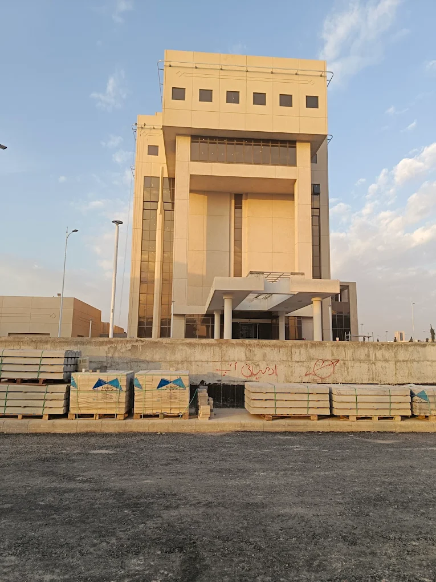
Facility Selection & Location
Chosen due to high population area
Easy public transport access
Supports smart building development
Regulatory compliance (ongoing)

Slide 5
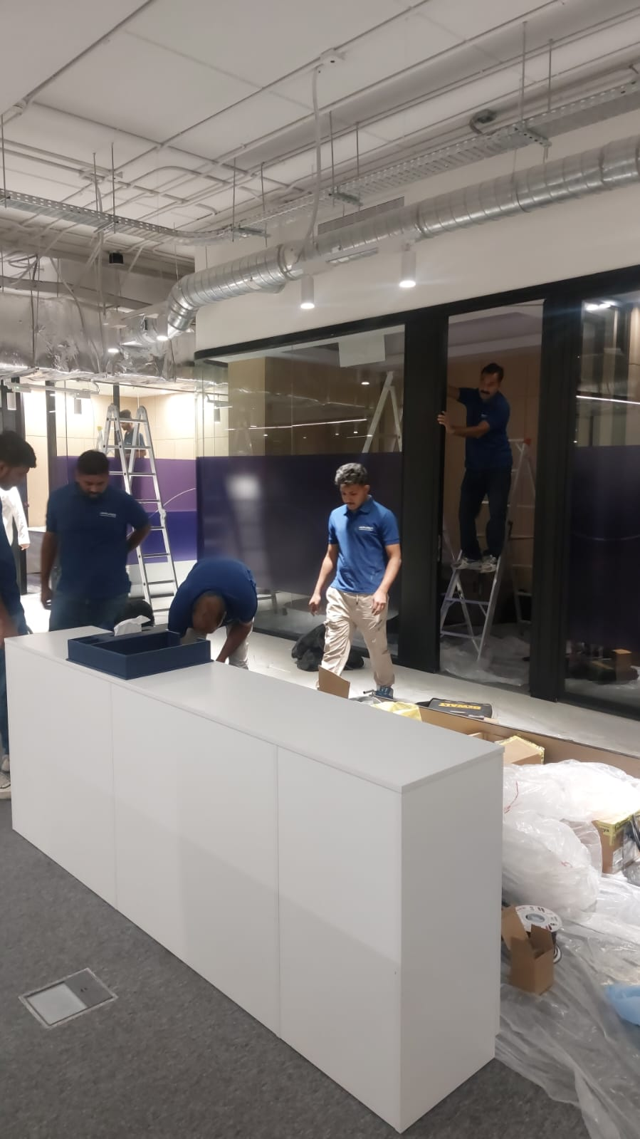
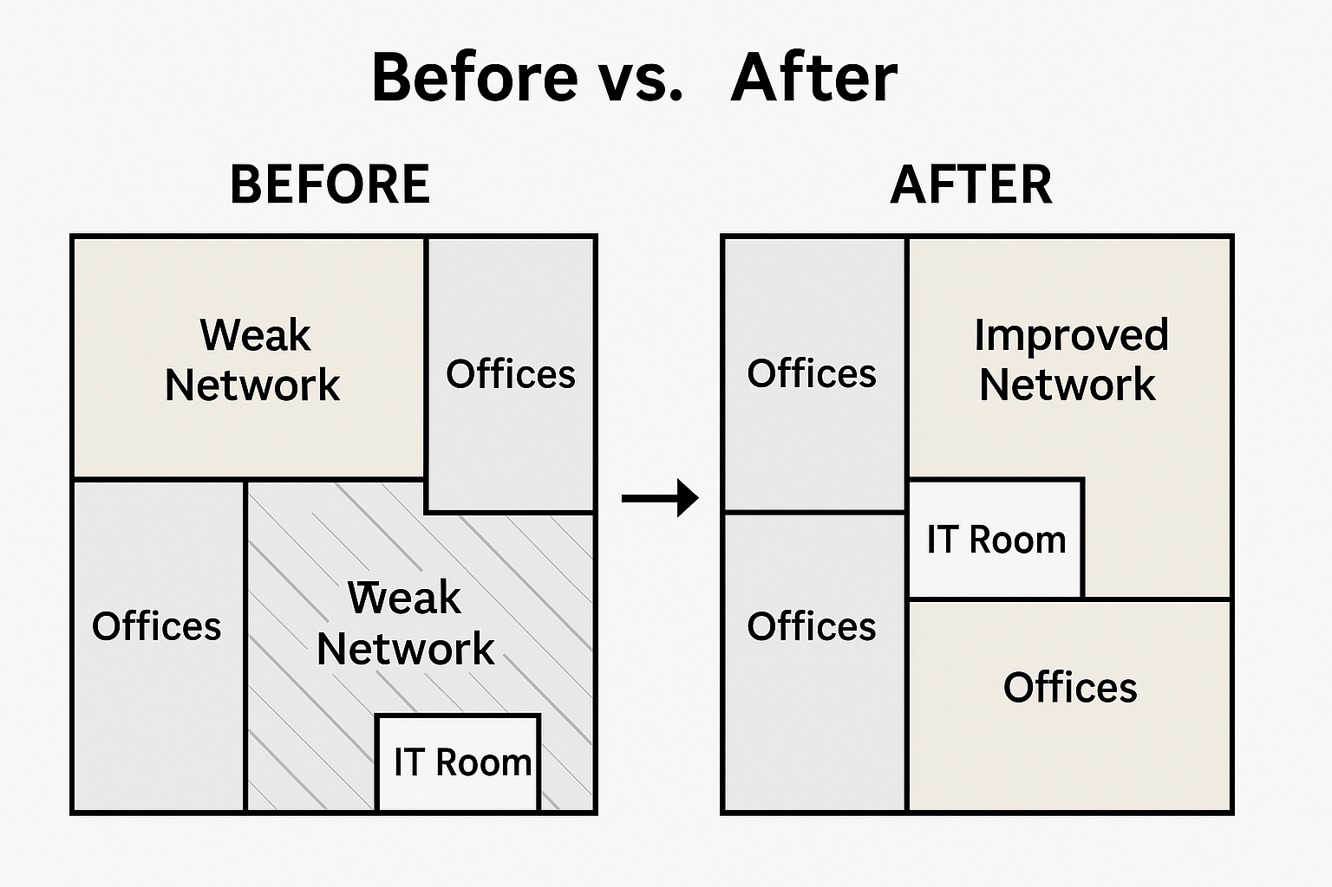
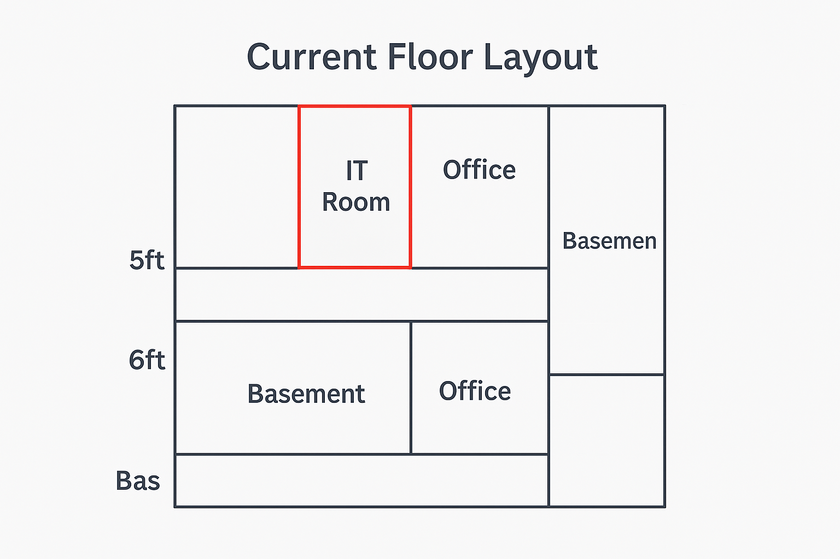
Layout & Space Utilization
IT Room relocation weakened network on 6th floor
Floor 5 has poor smart system integration
Rooftop and basement unused due to lack of systems
Suggestions: Improve networks, utilize rooftop and basement

Slide 6
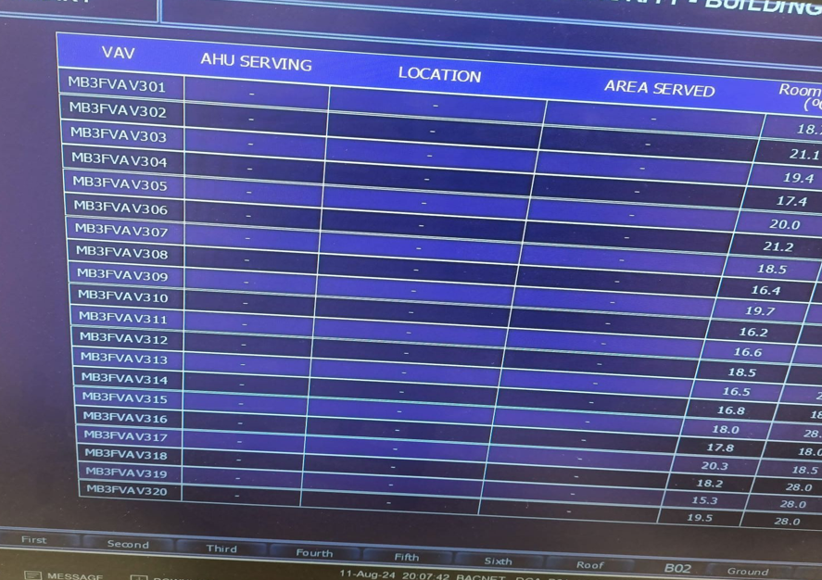
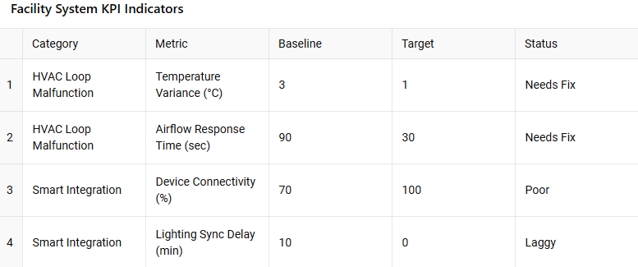
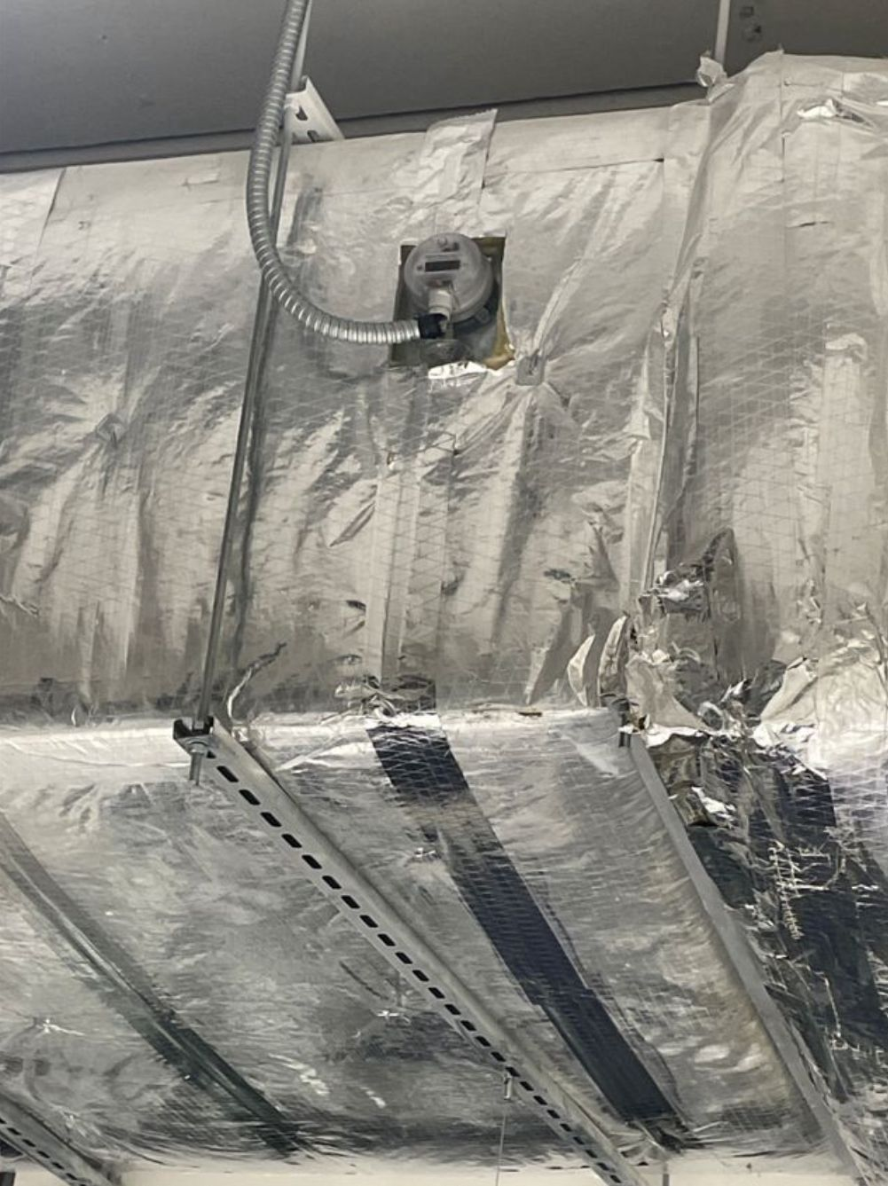
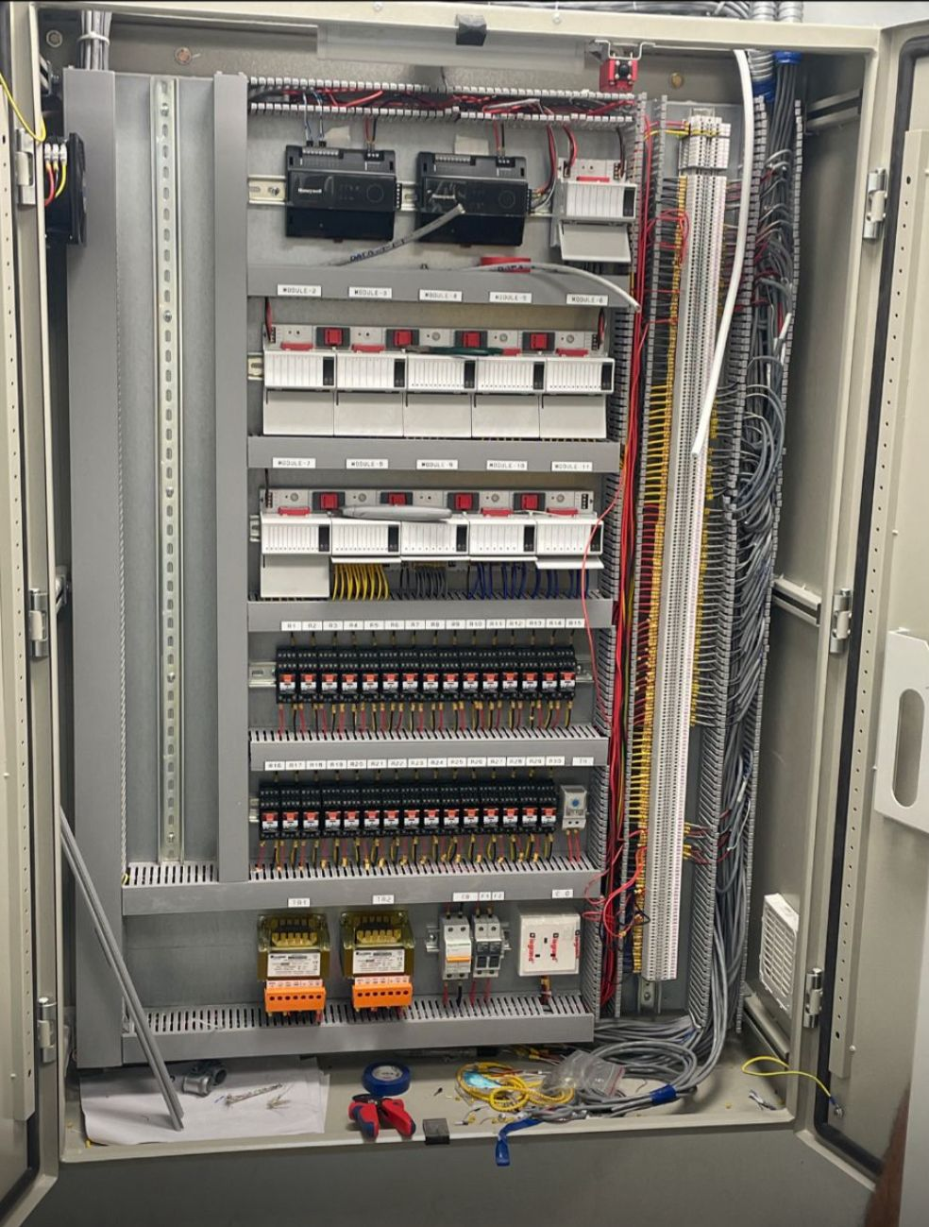
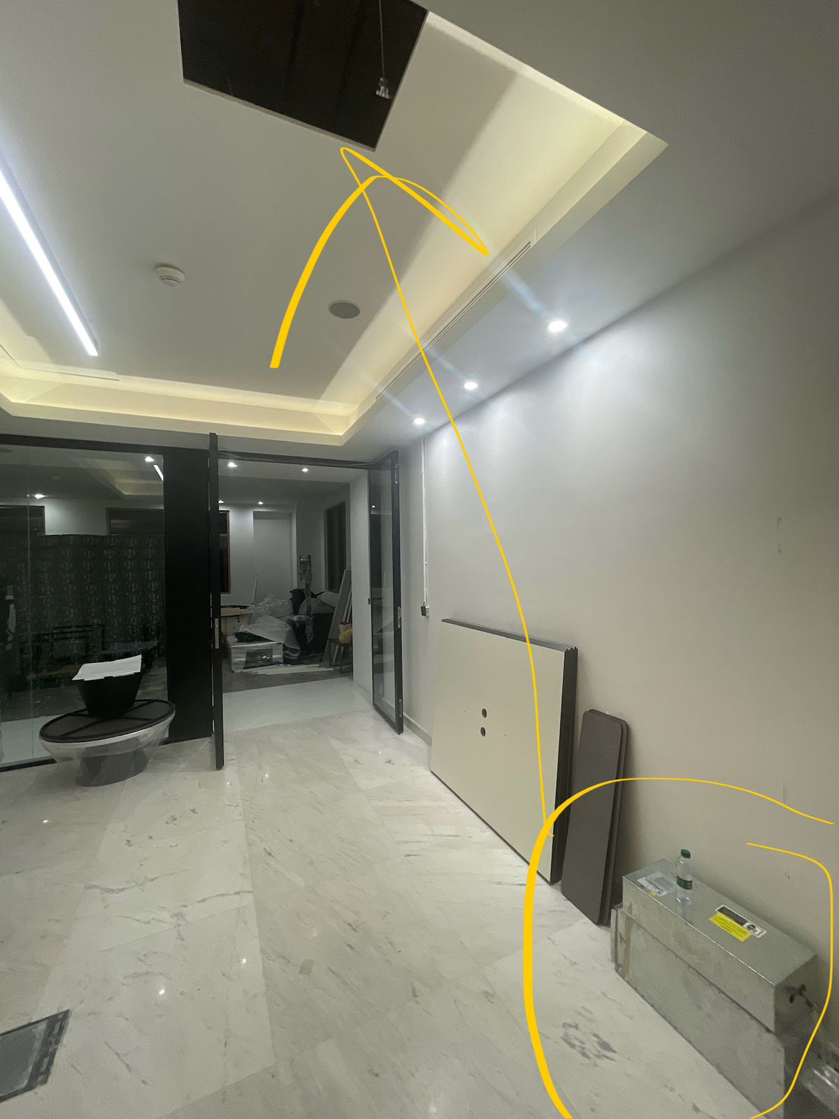
Operations & Maintenance
HVAC partially installed; loop malfunction on ground floor
Electric Submeters
No preventive maintenance in place
Suggestions:
Install and test HVAC
Introduce centralized Building Management System
Electric Submeters for all floors
VAV
BMS

Slide 7
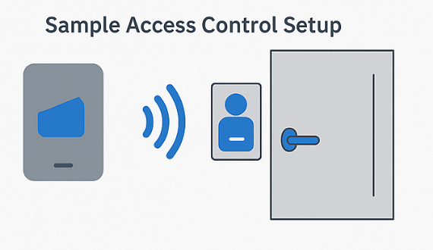
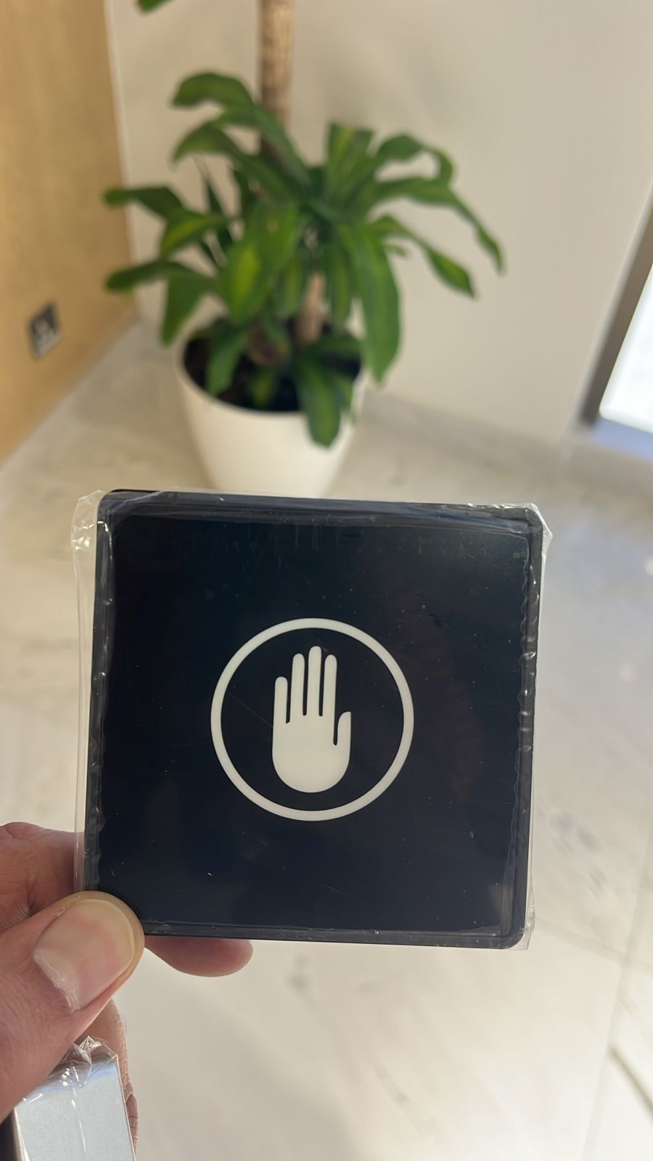
Safety & Risk Management
Incomplete access control (fingerprint/card)
CCTV placement needs review
Emergency systems need validation
Recommendations:
Install access systems
Finalize CCTV and fire safety integration

Slide 8
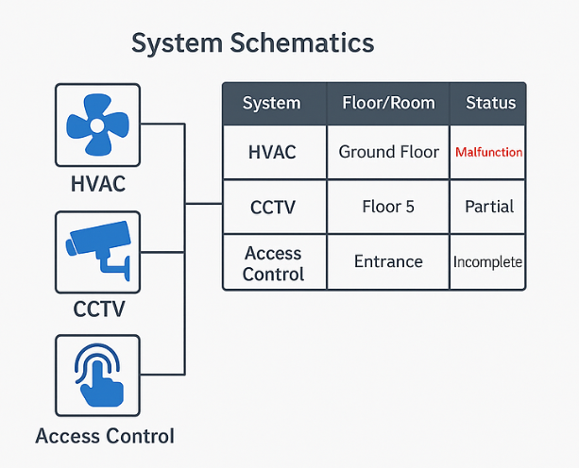
Project Management Plan
Tasks:
Network reassessment (Floors 5 & 6)
HVAC & access system completion
Status:
Ground floor configuration starting soon
Rooftop: 2 days of work needed
Schedule:
1 week: CCTV & cables
2–3 weeks: HVAC, access
1 month: Full integration/testing

Slide 9
Conclusion & Reflection
Progress made, but delayed by technical dependencies
Missing systems affect smart building goals
Need for proactive management and regular maintenance

Slide 10
Thank you

